Slide 1
GBS Debit Routing Intern Project Summer 2020
Vedant Bhat & Rakesh Gorrepati
Eric Poliashenko
August 2020

Slide 2
Project Team
Associate | Role | Background
Vedant Bhat | Application Developer (Intern) | B.S. in Computer Science at Georgia Tech, 2023
Rakesh Gorrepati | Application Developer (Intern) | B.S. in Computer Science at Georgia Tech, 2021
Eric Poliashenko | Mentor | B.S. in Computer Science from Georgia Tech
Jack Eubanks | Mentor | Senior Application Developer
Mark Pearson | Manager | Principal IT Architect
Stephen Mathews | Manager | IT Director

Slide 3
Agenda
Summary
Business Problem
Solution Details
Process/Challenges
Impact/Takeaways

Slide 4
Business Problem
The Debit Routing Determination (DRD) system is used in order to route debit transactions to different networks based on certain factors such as transaction amount, Merchant ID, and BIN

Slide 5
Business Problem (Cont.)
Previously, developers had to manually submit a request to add a route to the DRD
The request had to be approved and fulfilled by a team member who had access to the QA database
This was a long process and could take up to 2 weeks, costing time and extra human resources
Notes:
Previously, developers attempting to query the DRD were forced to submit a request to a team member who has control of the QA database. The member would then have to add additional routes to the logic in the database. This process is tedious and can take up to 2 weeks while also utilizing human resources.

Slide 6
The Project
A simple and clean java GUI tool to allow for queries to the DRD
Often developers don’t have a specific debit route in mind, but they want a specific network response from the DRD
The goal for our project was to devise this capability for other Frontend groups, who work with the DRD, to quickly receive a desired response from the DRD without having to do all the extra work or spend the time to acquire it through its normally tedious process
The result was a simple and effective local application that enables developers to quickly input attributes and send a query to the DRD

Slide 7
The Solution
Created a local application with JavaFX
Developed a simple and minimalistic UI which is easy to use
Provides an alternative to the process of submitting a request with a 1-minute alternative

Slide 8

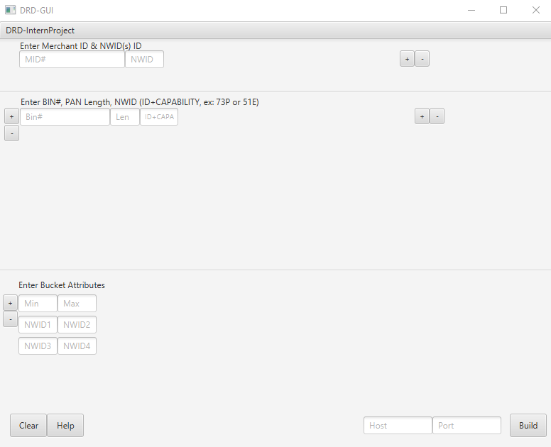

Slide 9
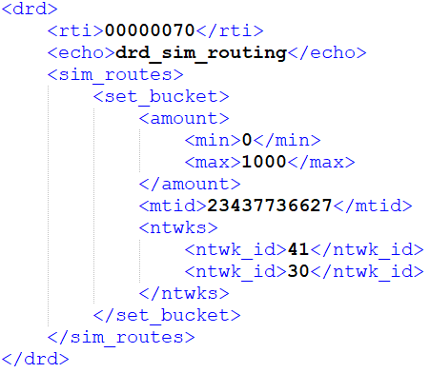

Slide 10
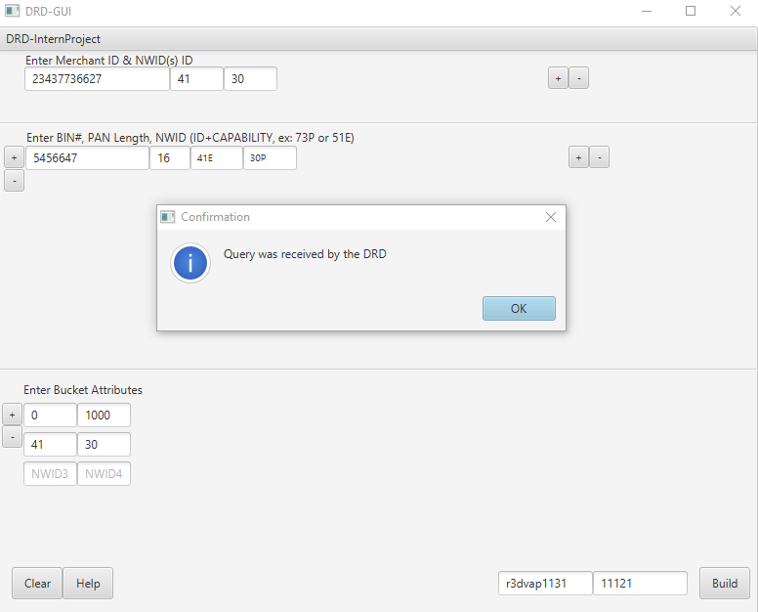

Slide 11
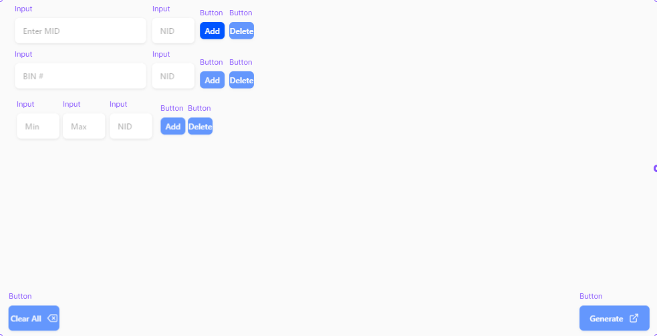
Timeline Overview
Week 1
Tech stack research
Swing vs JavaFX
Week 2
UI design / Wireframing
Familiarization with DRD System
Week 3 - 5
Developed application
Utilized JavaFX
Week 6
Final testing
Presentation

Slide 12
Challenges
Remote Work Environment
Understanding how the DRD is queried
Software Issues/Software not being received

Slide 13
Internship Takeaways
We gained exposure to Software Development in FinTech
Full Stack App Development, Socket Programming, Java Persistence
Designing UI in JavaFX
Better Understanding of Debit Routing
Experience Working in a Remote Environment
Familiarization with different Version Control Systems

Slide 14
Conclusion
We created an application to reduce the amount of time it takes developers to get a simulated response from the DRD
Project requirements were met

Slide 15
Questions

